Slide 1
Constructing bar charts by utilising technology
Task A: Creating bar charts on spreadsheet software
The flower sales at a garden centre are recorded.
Create a bar chart for this list of data: rose, tulip, marigold, viola, rose, rose, marigold, viola, daffodil, tulip, daffodil, petunia, marigold, daffodil, rose, tulip, petunia, petunia, tulip, marigold, rose, viola, rose, petunia, viola, viola Ensure it has a title on both axes.
Would you advise the garden centre to order an equal amount of each flower next time or different amounts? Explain your answer.
Create a bar chart for this table of data about visitors to a museum.
Day of the week | Frequency
Monday | 28
Tuesday | 25
Wednesday | 32
Thursday | 27
Friday | 34

Slide 2
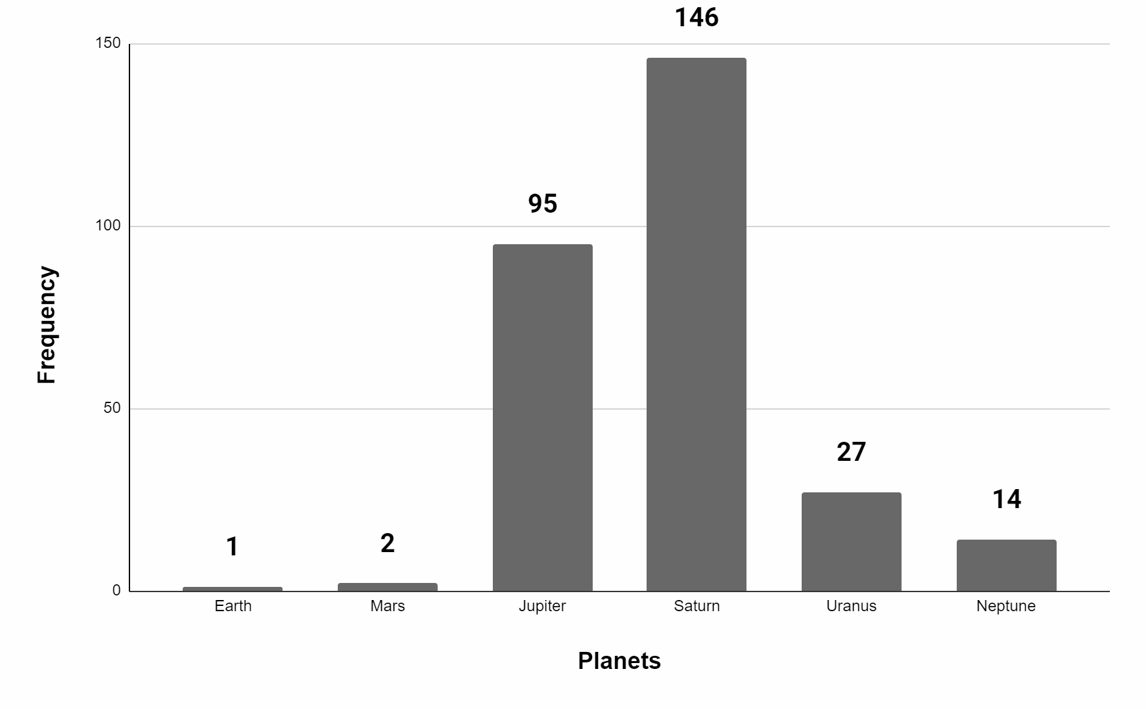
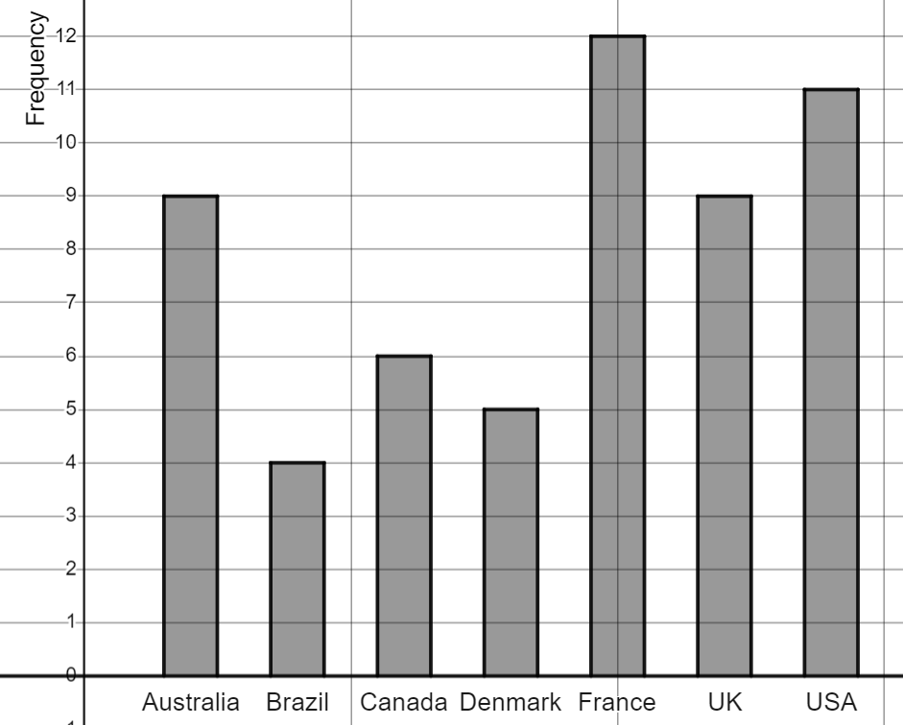
Constructing bar charts by utilising technology
Create a bar chart for this table of data about visitors to a museum.
Day of the week | Frequency (week 1) | Frequency (week 2)
Monday | 28 | 24
Tuesday | 25 | 23
Wednesday | 32 | 34
Thursday | 27 | 26
Friday | 34 | 32
What is different about this bar chart?
Task B: Creating bar charts using a template file
Using the Template file 🖇 recreate this bar chart.
Task B Question 2 🖇 recreate this bar chart showing the number of time zones per country (including overseas territories).
Mathematics in Education and Industry.
Google Sheets is a trademark of Google LLC and this content is not endorsed by or affiliated with Google in any way.
v2.1

